Slide 1
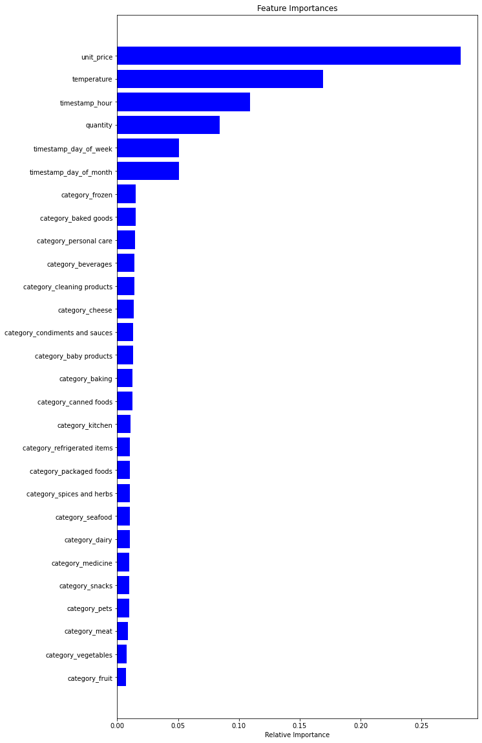
Key insights from Data Modelling for Gala Groceries for stock prediction
Model experimentation: Tested K-fold analysis algorithm with cross validation.
More data required: Average MAE is 24% with the current set of data and features that were created. In order to test this model for production, we need larger samples.
Model feature importance visualisation: This feature importance visualisation tells us:
The unit price and hour of day are important but the product categories are not important for stock prediction.
Need for more features: Are there more features about the products that we can use to include in the model?
Scope of IOT: The temperature collected by sensors is also important for predicting stock.

